Slide 1


MEDIA MENGAJAR
BRIGHT AN ENGLISH
FOR SMP/MTs GRADE VIII

Slide 2

Chapter 8
In a Faraway Kingdom
Notes:
Jika terdapat gambar cantumkan sumber gambar dgn ukuran font 10pt

Slide 3
A. ……….
In this chapter, we will learn to:
interact and exchange ideas, experiences, interests, opinions, and views with teacher and peers;
identify a kind of narrative texts;
identify the purpose of a folktale;
identify the morals in a folktale;
identify parts of a folktale;
learn vocabulary related to folktales;

Slide 4


Folktales
A folktale is a narrative text telling a story that is mainly used to entertain or amuse readers or listeners.

Slide 5
Generic Structures
Orientation
Evaluation
Complication(s)
Resolutions
Reorientation
Events or situations or background information that introduce or lead to complication or crisis.
It is usually found in the first paragraph. Introduces the characters and the setting of the story.
The main character faces a complication or crisis.
How the complication or crisis is resolved.
Sums up the whole story with the morals or lessons implied.

Slide 6
Read the following text.
Poor Mr Lebai (Pak Lebai Malang)
A long time ago, a man called Mr Lebai lived on a river bank in a village in West Sumatra. One day, he received two party invitations–one from a villager upstream and another one downstream. The two parties’ locations were far from each other. However, the parties were to take place exactly at the same time.
Not wanting to miss both parties, he started rowing his boat downstream for he knew that the food there was very delicious. In the middle of his journey, he stopped. Mr Lebai remembered that the host of the upstream usually gave more food to the guests, so he turned his boat back and started to row upstream.

Slide 7
Poor Mr Lebai (Pak Lebai Malang)
After rowing for several minutes, he stopped again. He remembered that the downstream host was a generous man. Mr Lebai thought that if he got there early, he would get a delicious buffalo head. He turned back to go to the downstream village. However, when he got there, the party in the downstream village was over. He saw people walking home, bringing bags of food. Mr Lebai was disappointed. He quickly turned his boat again headed for the upstream village.

Slide 8
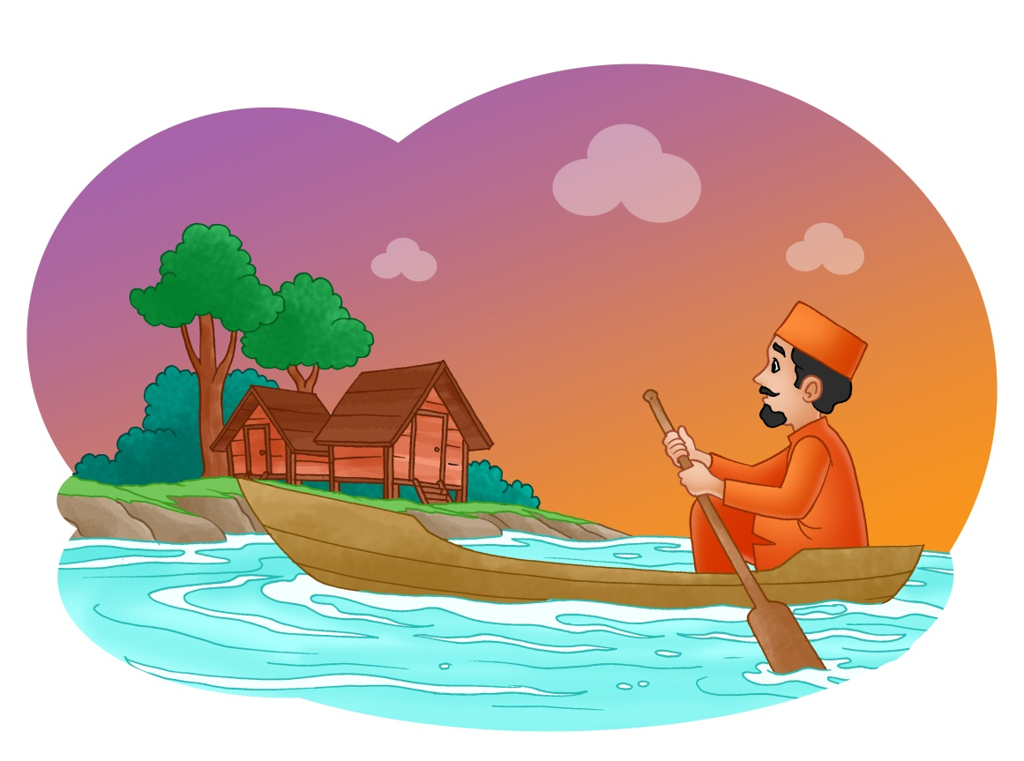
Poor Mr Lebai (Pak Lebai Malang)
He rowed as fast as he could. However, in the middle of the journey, he saw people walking home bringing their bags of food, too. It meant the party in the upstream was also over. In the end, Mr Lebai went home empty-handed, disappointed, and exhausted. He was so unfortunate. Thereafter, he was nicknamed “Pak Lebai Malang” or “Poor Mr Lebai.”

Slide 9
GOOD JOB!

